Slide 1

Test Cricket Batting Data Analysis
This project focuses on cleaning and exploring Test cricket batting statistics. We transform raw data into a structured format. Then, we gain insights through exploratory data analysis and visualization.

Slide 2

Dataset Overview
The dataset contains historical Test cricket batting records. It includes various player statistics. Key stats are matches played, runs scored, and batting average.
Matches Played
Total games played by the batsman
Runs Scored
Total runs accumulated
Strike Rate
Runs per 100 balls faced
Batting Average
Total runs divided by total dismissals

Slide 3
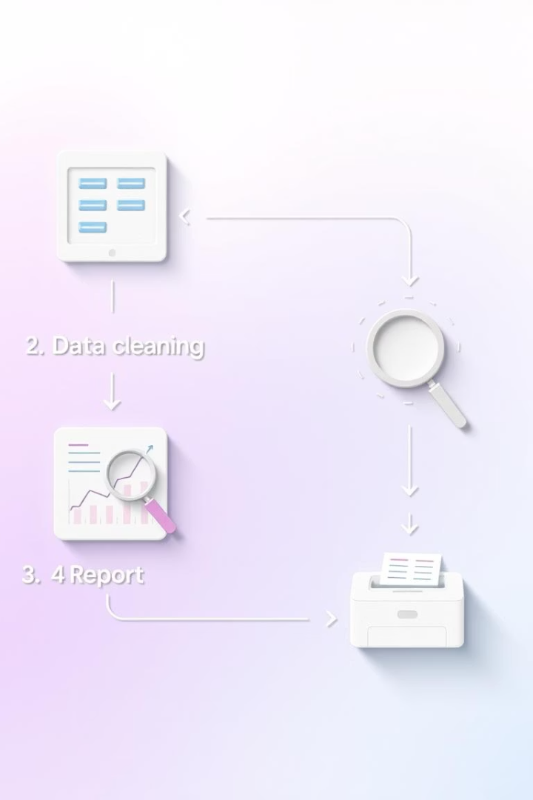


Project Workflow
Our project follows a clear, step-by-step process. We begin with library imports and data loading. This ensures a smooth analytical flow.
Import Libraries
Essential libraries like pandas and matplotlib are imported.
Load Dataset
The CSV file is loaded into a Pandas DataFrame.

Slide 4

Data Cleaning & Preparation
This crucial phase transforms raw data. We ensure data is structured and accurate. This prepares it for robust analysis.
Column Renaming
Columns are renamed for improved clarity.
Missing Values
Missing values are handled appropriately.
Duplicate Removal
Duplicate entries are identified and removed.
Feature Extraction
Features like Country and Years are extracted.

Slide 5

Feature Engineering
We extract new, valuable features from existing data. This enhances our dataset for deeper insights. It includes player country and career span.
Country Extraction
Rookie Year
Country information is extracted from player names.
The player's debut year is identified.
Final Year
The player's last active year is determined.

Slide 6
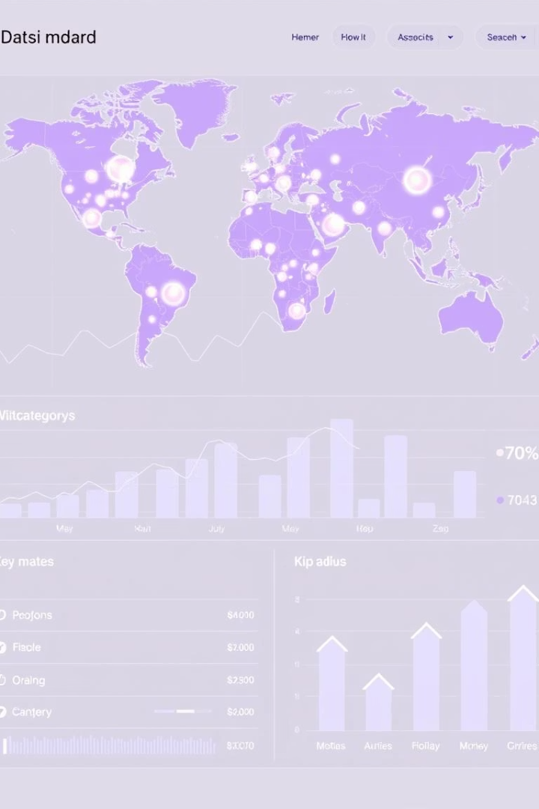



Exploratory Data Analysis (EDA)
EDA helps us understand data patterns. We use statistical summaries and visualizations. This reveals key characteristics and relationships.
Statistical Summary
Matches Distribution
Correlation Heatmap
Overview of dataset statistics.
Distribution of matches played by players.
Visualizing correlations between numerical features.

Slide 7
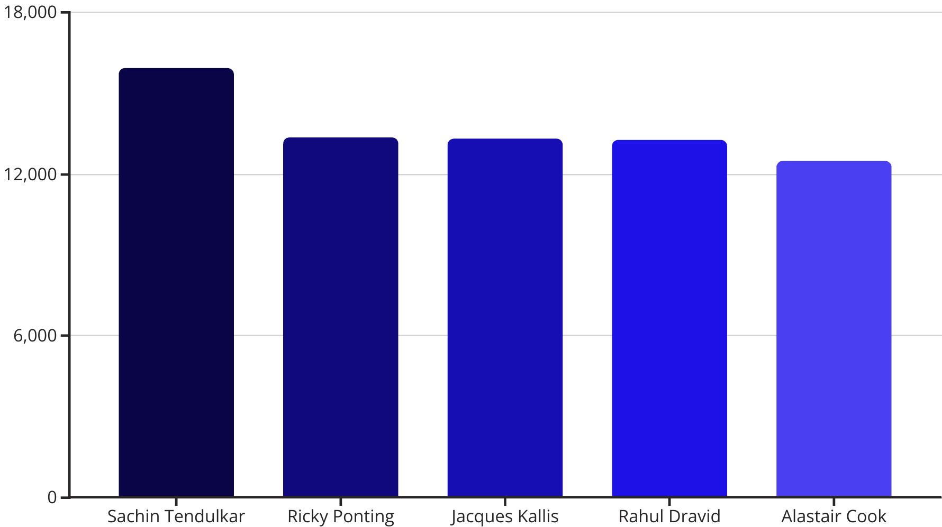
Top 10 Run Scorers
We visualize the top performers in Test cricket. A bar chart highlights the highest run-scorers. This provides a clear ranking of batting legends.

Slide 8
Key Skills Demonstrated
This project showcases essential data science skills. From cleaning to visualization, it covers a comprehensive workflow. These skills are transferable to various data analysis tasks.
Data Cleaning
Feature Engineering
Data Visualization
Python Proficiency
Transformation
Creating new features
Matplotlib
Pandas
Handling missing values
Extracting insights
Seaborn
NumPy

